Slide 1
COVID-19 ve Turkey
How to assess the impact?
Güven SAK
2 April 2020
tepav
Türkiye Ekonomi Politikaları Araştırma Vakfı

Slide 2
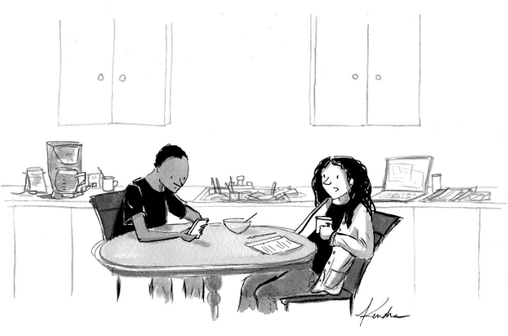
‘’Are you talking about the new normal of an hour ago, or is there a new new normal right now?’’

Slide 3
How it has changed so far in TR
First COVID-19 case of Wuhan was in December 2019
  It was a news item from a faraway country
Then Lombardia has become the epicenter in February 2020
  Although Mediterranean, still faraway from Turks
WHO declared COVID-19 outbreak a pandemic
  Still no campaign here
  We have started learning about physical distancing after the Minister of Health has started his daily briefings in March 11

Slide 4
Framework
How deeply we were all wrong in global risk assessment?
  It’s not only about Turkey
First notes on Turkey
  Why expect more damage in countries like Turkey?
Impact assessment in Turkey
  What to expect for 2020 now?
    Negative growth
    Rising unemployment

Slide 5
Economic
Environmental
Geopolitical
Societal
Technological
 | 2008 | 2010 | 2012 | 2014 | 2016 | 2018 | 2020
1. | Blow up in asset prices | Asset price collapse | Income disparity | Income disparity | Involuntary migration | Extreme weather | Extreme weather
2. | Middle East instability | China economic slowdown | Fiscal imbalances | Extreme weather | Extreme weather | Natural disasters | Climate action failure
3. | Failed and failing states | Chronicdisease | Greenhouse gas emissions | Unemployment | Climate action failure | Cyberattacks | Natural disasters
4. | Oil price shock | Fiscal crises | Cyberattacks | Climate action failure | Interstate conflict | Data and fraud | Biodiversity loss
5. | Chronic diseases | Global governance gaps | Water crises | Cyberattacks | Natural catastrophes | Climate action failure | Human-made environmental disasters
In terms of likelihood
 | 2008 | 2010 | 2012 | 2014 | 2016 | 2018 | 2020
1. | Blow up in asset prices | Asset price collapse | Financial failure | Fiscal crises | Climate action failure | Weapons of mass destruction | Climate action failure
2. | Deglobalization (developed) | Deglobalization (developed) | Water crises | Climate action failure | Weapons of mass destruction | Extreme weather | Weapons of mass destruction
3. | China hard landing | Oil price spikes | Food crises | Water crises | Water crises | Natural disasters | Biodiversity loss
4. | Oil price shock | Chronic disease | Fiscal imbalances | Unemployment | Involuntary migration | Climate action failure | Extreme weather
5. | Pandemics | Fiscal crises | Energy price volatility | Infrastructure breakdown | Energy price shock | Water crises | Water crises
In terms of impact
Source: World Economic Forum, Global Risk Report 2020, TEPAV visualizations

Slide 6
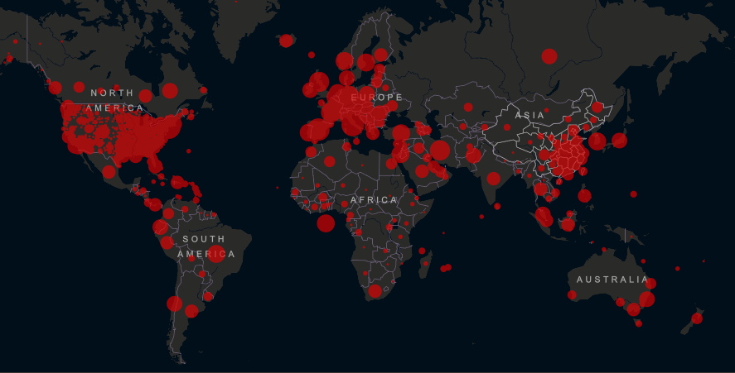
Number of cases passed 1 million last evening
Source: Coronavirus COVID-19 Global Cases by the Center for Systems Science and Engineering (CSSE) at Johns Hopkins University

Slide 7
From the first to the 1000th case had taken 12 days in Turkey:Korea vs Italy
In countries where the number of cases exceeds 9000, the period from the first case to the 1000th case, the period from 1000th case to 4500th case, and from 4500th case to 9000th case, days
 | 1 case - 1000 cases | 1000 cases - 4500 cases | 4500 cases - 9000 cases
Turkey | 12 | 6 | 3
US | 50 | 6 | 4
Italy | 30 | 7 | 4
Spain | 38 | 5 | 4
China | 26 | 4 | 4
Germany | 42 | 7 | 4
France | 45 | 8 | 5
Belgium | 42 | 10 | 5
Iran | 13 | 5 | 6
United Kingdom | 44 | 8 | 6
Switzerland | 18 | 8 | 6
Netherlands | 18 | 9 | 7
Austria | 21 | 8 | 8
South Korea | 36 | 7 | 23
Source: Coronavirus COVID-19 Global Cases by the Center for Systems Science and Engineering (CSSE) at Johns Hopkins University

Slide 8
Why more serious in Turkey
Individuals
  Low savings
  Lack of a general social safety net
Companies
  Micro and SMEs
  Importance of trade credits in corporate finance
Public institutional capacity
  Urban problem yet too centralized a unitary state
    Capacity of local admins
  Admin reform eroded policy making capacity

Slide 9
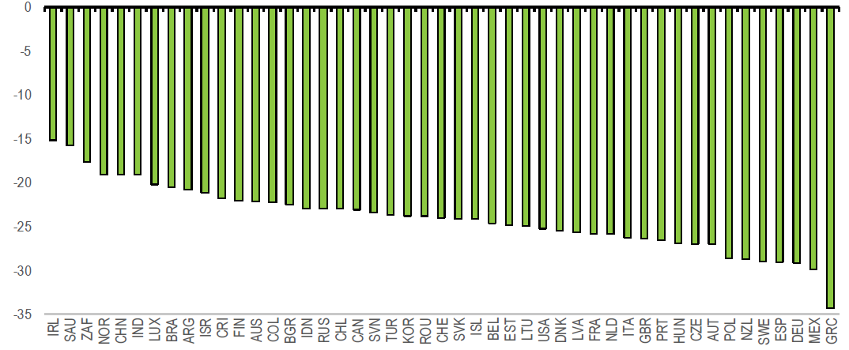
The potential initial impact on activity of partial or complete shutdowns on activity in selected advanced and emerging-market economies
OECD growth impact: -23 percent
0
-5
-10
-15
Per cent of GDP at constant prices, %
-20
-25
-30
-35
Source: OECD Evaluating the Initial Impact of COVID Containment Measures on Activity, TEPAV visualizations

Slide 10
Electricty consumption is important indicator to follow economic crises
Electricity consumption is declining as long as number of confirmed cases increased both in Italy and Turkey
Energy consumption and the number of cases after COVID-19, compared to previous year, Turkey, Italy, Germany and Spain
 | Electricity consumption rate compared to the same week of the previous year, 08-18 hours on weekdays, 2020/2019 |  |  |  | Total confirmed cases
 | Germany | Spain | Italy | Turkey | Germany | Spain | Italy | Turkey
Week of Feb. 17 | 102% | 97% | 98% | 106% | 16 | 2 | 20 | 0
Week of Feb. 24 | 101% | 99% | 97% | 95% | 48 | 32 | 888 | 0
Week of March 2 | 99% | 101% | 102% | 100% | 670 | 400 | 4636 | 0
Week of March 9 | 99% | 98% | 93% | 98% | 3.675 | 5.232 | 17660 | 5
Week of March 16 | 97% | 92% | 78% | 116% | 19.848 | 20.410 | 47021 | 670
Week of March 23 | 92% | 90% | 74% | 94% | 50.871 | 65.719 | 86498 | 5698
March 30- April 1st | 94% | 81% | 71% | 88% | 77.872 | 104.118 | 110.574 | 15.679
Source: Coronavirus COVID-19 Global Cases by the Center for Systems Science and Engineering (CSSE) at Johns Hopkins University (JHU), ENTSO-E Transparency Platform, TEİAŞ YTBS, TEPAV calculations

Slide 11
It is necessary to consider the distribution of informal employment with the service sector, which will be affected negatively by the crisis
Formality and informality rates across regions, %, 2017
Formal
Inormal
Source: World Bank ’’Job Diagnostics Turkey’’, 2019, TEPAV visualizations

Slide 12
Impact of coronavirus (COVID-19) on consumer spending in the United States as of March 2020, by retail category
Source: Statista, TEPAV visualizations

Slide 13
Debit and credit card expenditures, annual and weekly change: March 27-week: 33 percent decline...
Health, Health Products, Cosmetics
Market and Shopping Centers
Various Food
E-Commerce Transactions
Direct Marketing
Annual change, %, 8 - 22 March 2019 ; 6 - 20 March 2020
Total
Food
Private Pension
Clothing and Accessory
Moto Transactions
Government/Tax Payments
Accommodation
Airlines
Customs Payments
Travel agencies/Forwarding
Weekly change, %, 13 - 20 March 2020
Source: CBRT, TEPAV calculations

Slide 14
TEPAV Retail Confidence Indicator - TEPE
TEPE (Seasonally adjusted series), May 2008-March 2020
Source: TEPAV Retail Confidence Indicator

Slide 15
TEPAV Retail Confidence Indicator - TEPE
Year-on-year change in sectoral TEPE, March 2020 (point)
Average
Source: TEPAV Retail Confidence Indicator

Slide 16
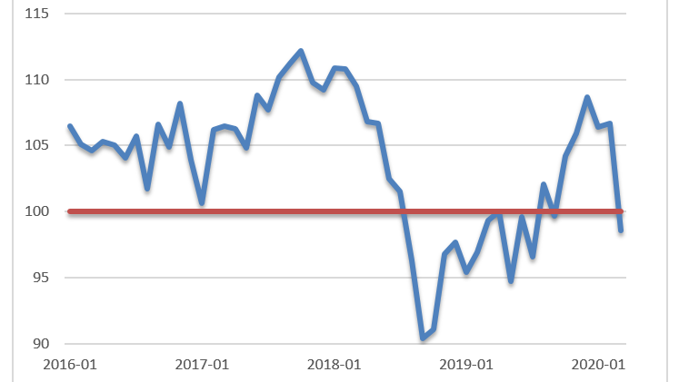
Real sector confidence index-TCMB

Slide 17
Turkey in top risks 2020
 | Per capita income | Social cohesion | Political capacity | Financial vulnerability | Real economy vulnerability | Healthcare preparedness
Germany | High
S. Korea | High
UK | High
US | High
China | Upper-middle
France | High
Spain | High
Italy | High
Turkey | Upper-middle
Iran | Upper-middle
Better performance
Worser performance
Source: Eurosia Group, World Bank, Bloomberg, World Tourism and Trave lCouncil, Harward Growth Lab, Lancet, TEPAV visualizations

Slide 18
’’It is not enough that we do our best; sometimes we must do what is required.’’
Winston Churchill

Slide 19
Conclusions
After a century we have a pandemics once again
  1918-1921 The Great Influenza
Physical distancing important to flatten the curve
  Whither Turkey? Korea or Italy
  12 to 18 months for the vaccine?
What is to be done?
  Projections and planning
    Planning for new product lines and health needs
  Social cohesion
    Major issue if it takes longer than two quarters
  Global cooperation
    Fiscal and monetary expansion not good for an open economy if it takes longer than two quarters

